Slide 1
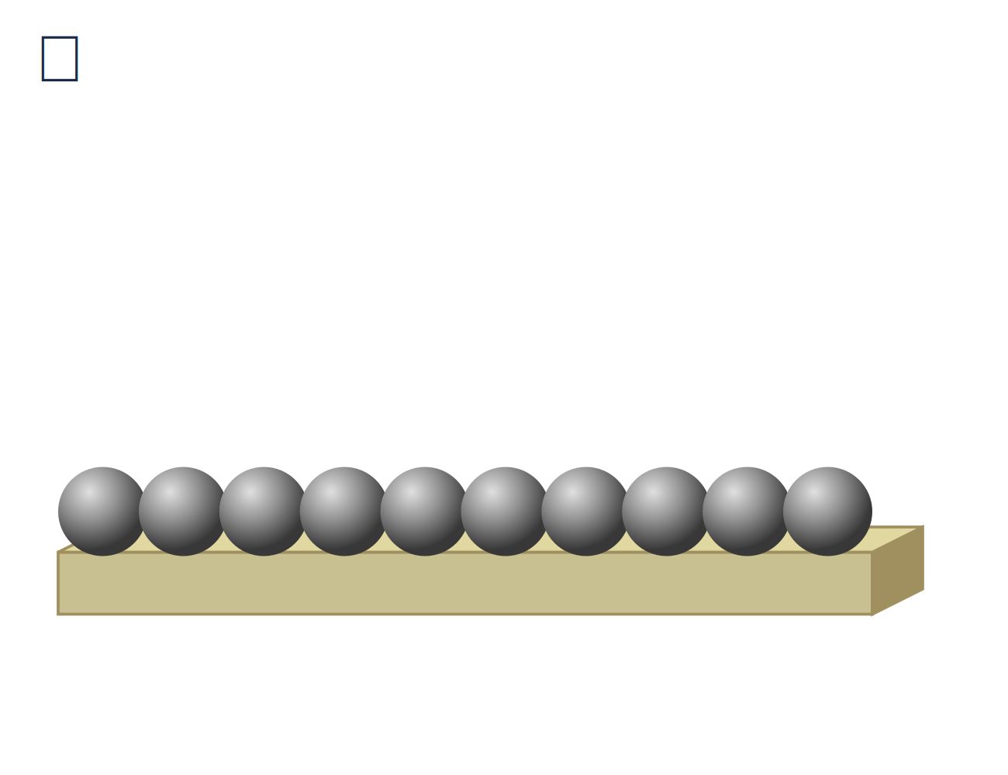
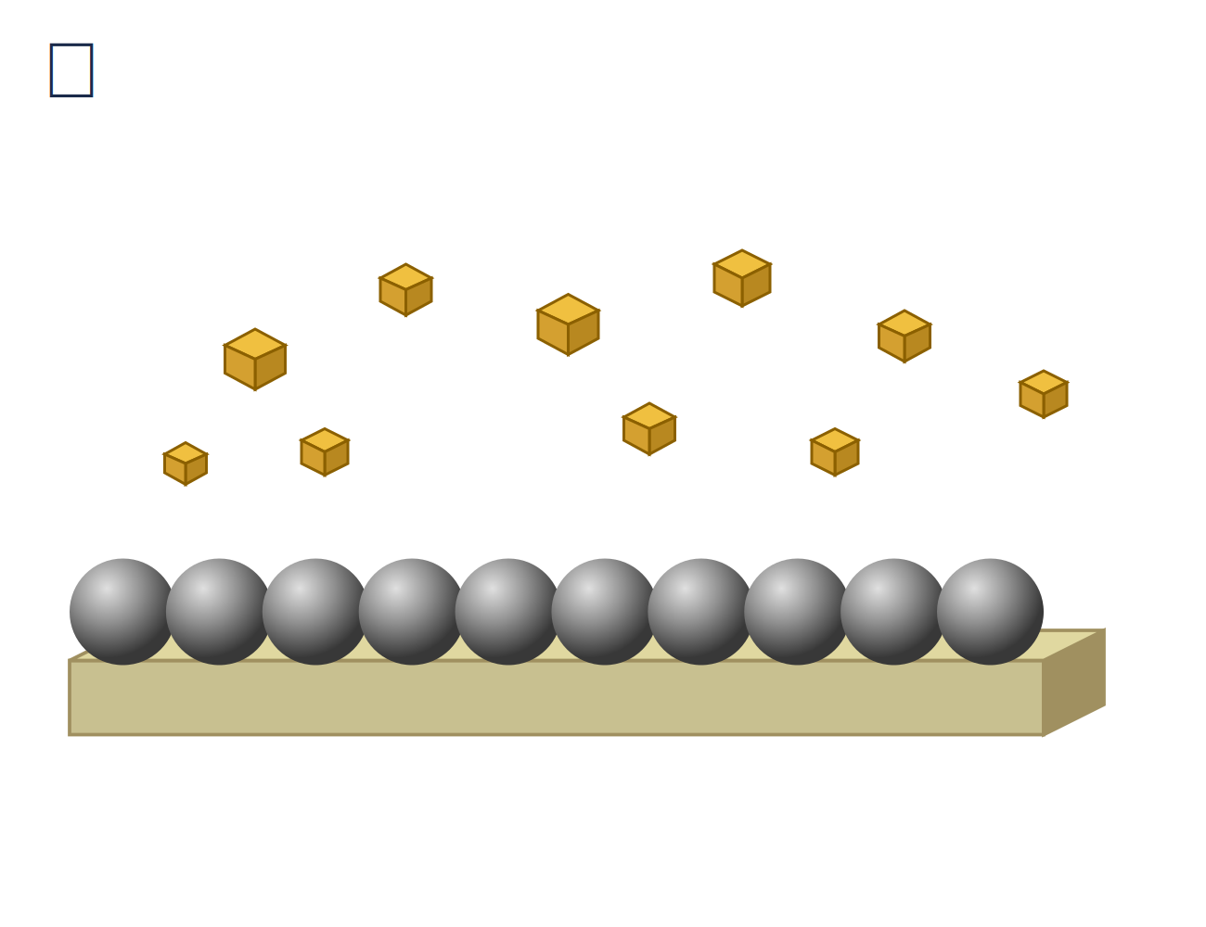
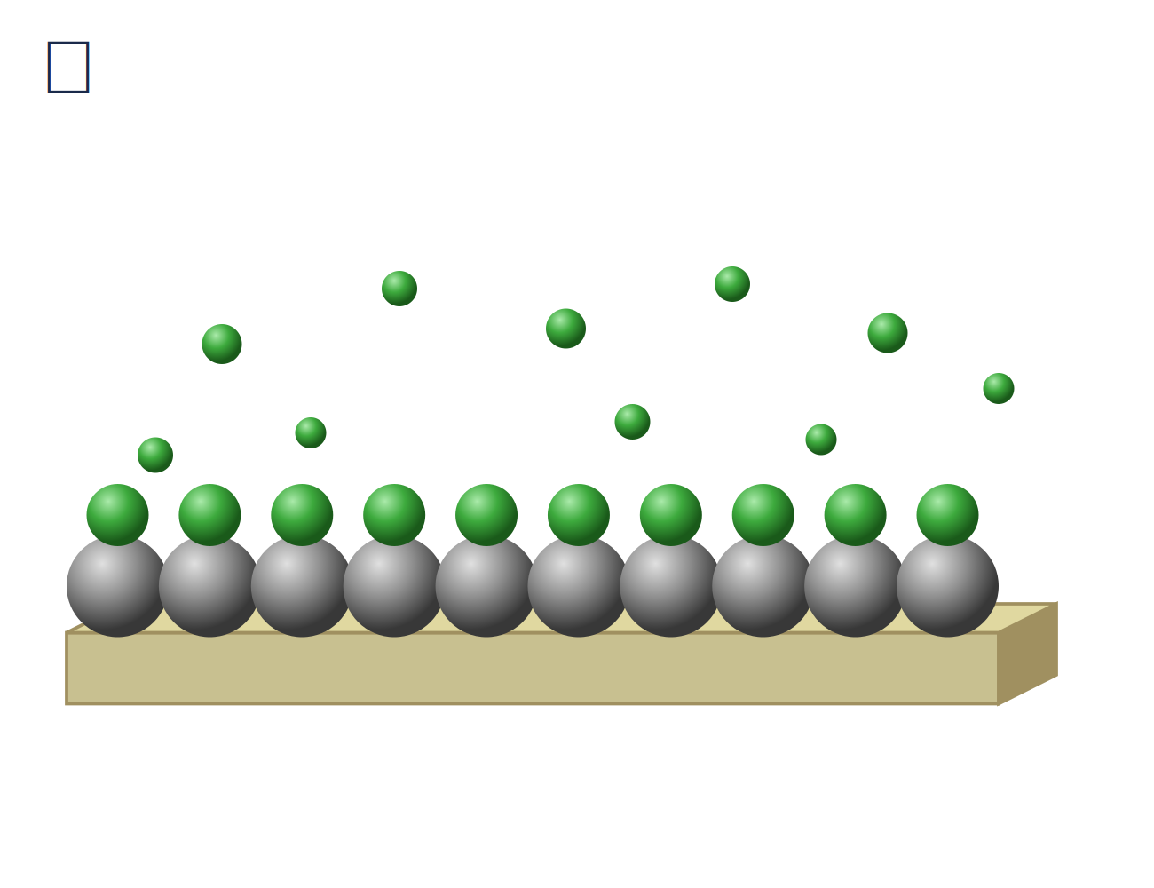
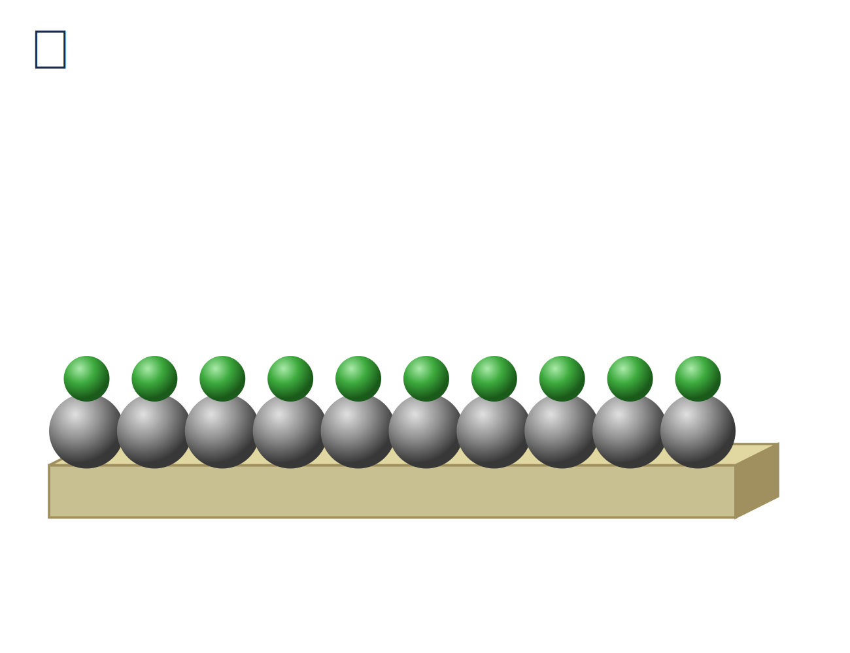
Atomic Layer Deposition (ALD) — 1 Cycle
Step 1
Step 2
ALD
cycle
Step 4
Step 3
ALD: self-limiting surface reactions — precise monolayer-by-monolayer growth

